Slide 1

TRAIL OF TEARS INDIAN
REMOVAL REMEBRANCE

Slide 2

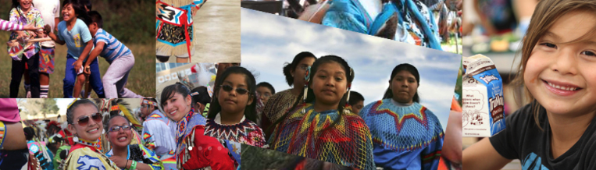
TRAIL OF TEARS INDIAN
REMOVAL REMEBRANCE
Mission
Provide a Circle of Support through health & wellness, cancer research, financial literacy and educational programs to restore a self-sustaining environment and better lives for Native American youth.

Slide 3
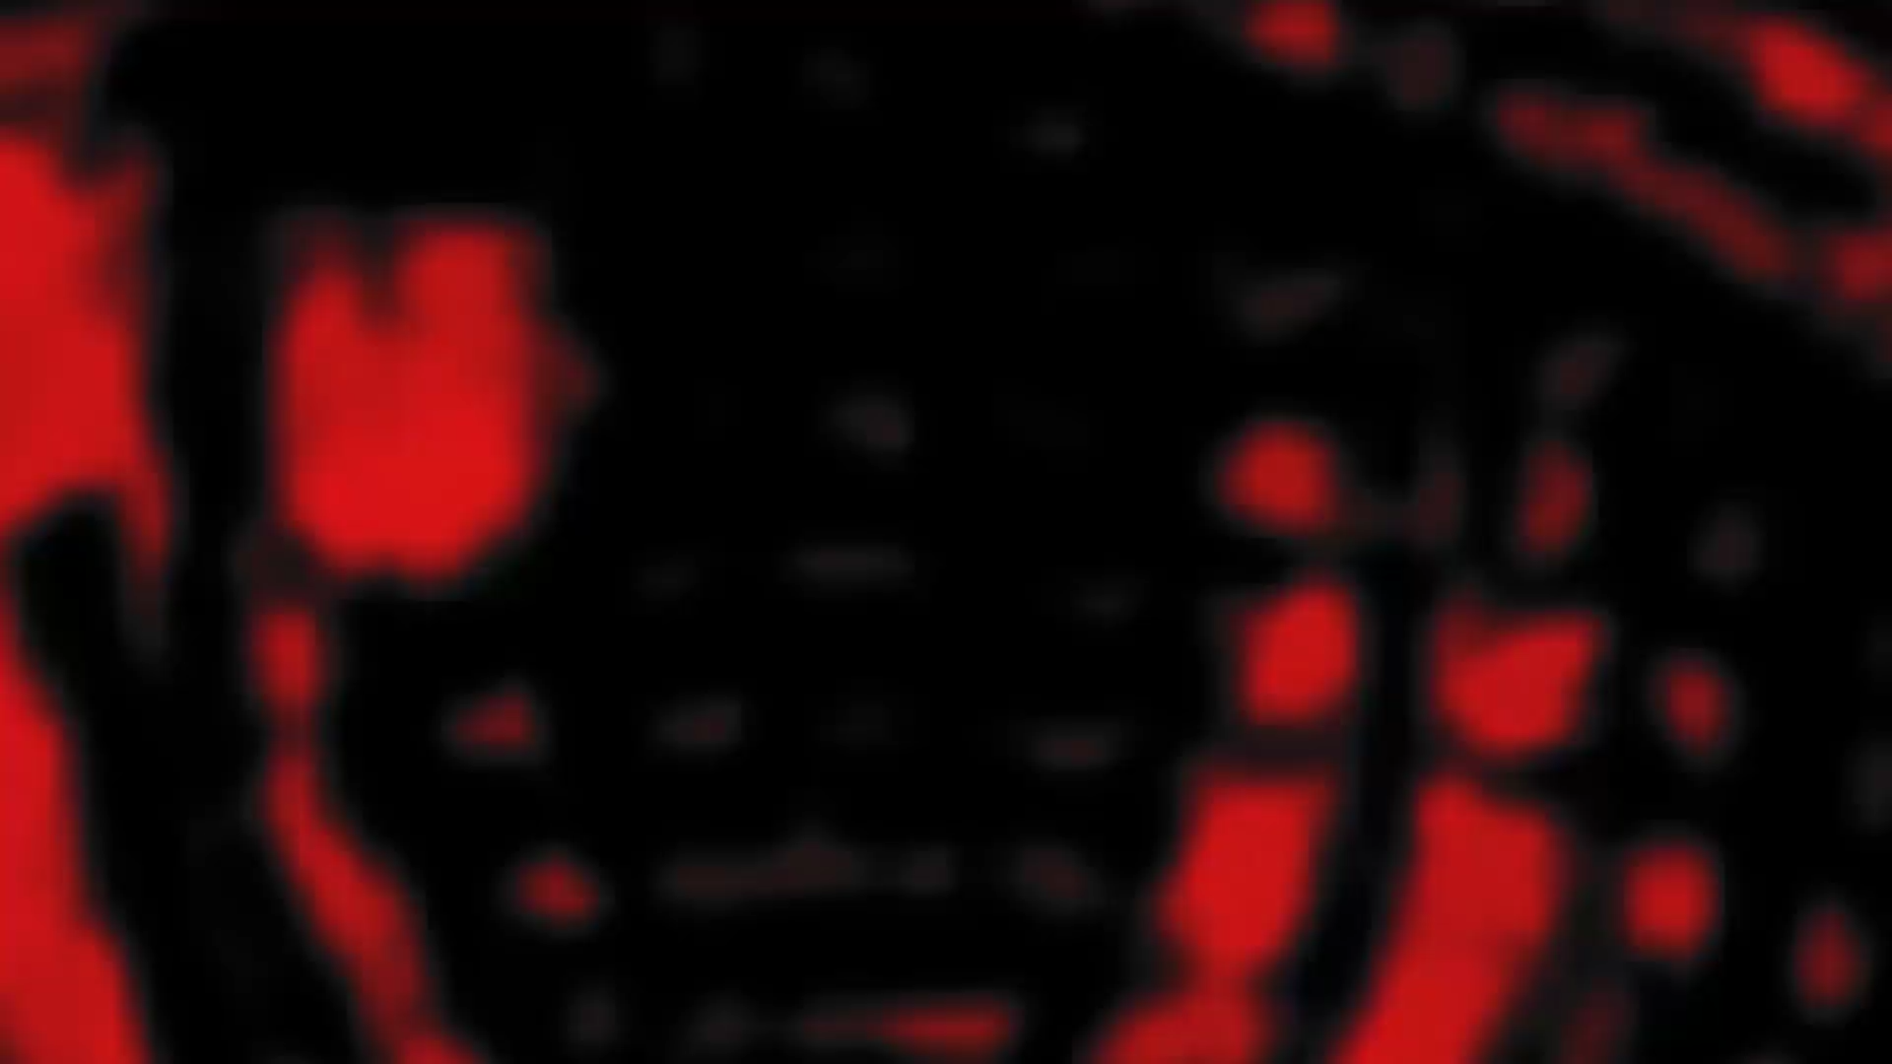

Slide 4
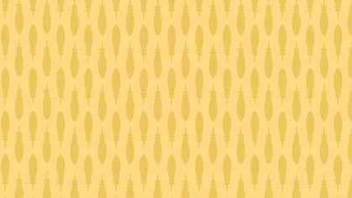
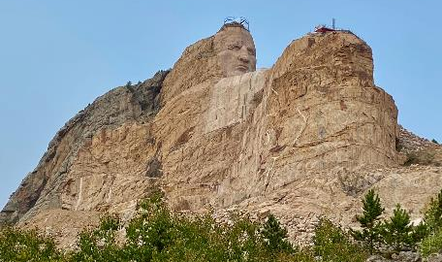
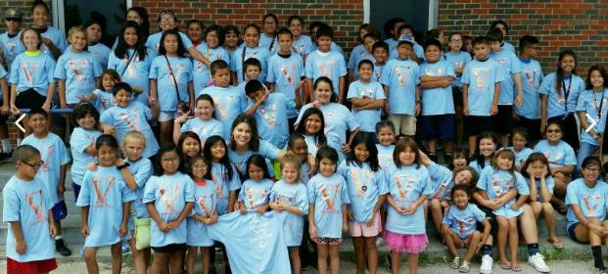
“In 1868, men came out and brought papers. We could not read them, and they did not tell us truly what was in them…When I reached Washington, the Great Father explained to me…that the interpreters had deceived me. All I want is right and justice.”
Red Cloud, ca 1822-1909
“We preferred hunting to a life of idleness on the reservation, where we were driven against our will…We preferred our own way of living…All we wanted was peace and to be left alone.”
Crazy Horse, ca 1842-1877
“Out of the Indian Approach to existence there came a great freedom, an intense and absorbing love for nature – enriching faith in a Supreme Power; and principles of truth, honesty, generosity, equity and brotherhood as a single guide to mundane relations.”
Luther Standing Bear, ca 1886-1939

Slide 5
TRAIL OF TEARS INDIAN REMOVAL REMEBRANCE
Timeline of Tragedy
President Andrew Jackson signs Indian Removal Act initiating resettlement of Native Americans
One infamous march, the “Trail of Tears” resettlement of Cherokee Nation, credited with over 8,000 deaths
1850+ U.S. realizing the prize of the West eventually sparking Great Plains wars of the 1860s-1880s
Treaty of Fort Laramie (2nd version of this treaty) officially forced Indians to cede large tracts of their lands to the U.S. and assigned all Native Americans to reservations. Thus, ending nomadic hunting ways of survival
General Allotment Act passed by Congress giving 160 acres of land per couple & 80 per single adult
Famous Western Land Run net loss +80 million acres out of 138 million
Citizenship Act made all American Indians citizens of the U.S.
Official U.S. survey finds horrific conditions and severe poverty
Tribe eradication era brings forced assimilation and loss of 109 tribes & 2.5 million prime acres by 1964
Indian Religious Freedom Act passed to protect/preserve inherent right of freedom to believe, express, and exercise traditional religions of the American Indian
Act added provision for enforcement of 1978 Act and ability to retain sacred sites
1994 Act extended 1978 Act making it legal to transport and use peyote for ceremonial purposes

Slide 6
TRAIL OF TEARS INDIAN REMOVAL REMEBRANCE
Timeline of Tragedy
Living conditions on the reservations have been cited as
“Comparable to Third World.”
(May 5, 2004, Gallup Independent)
Casinos do benefit select tribes
Geographic proximity to a customer base = big dollars
Only approximately 30 out 650 tribes have that luxury
Non-casino tribes challenged for sustainability
Bad lands = sparse natural resources and limited herds (roaming or raised)
  Poverty is crippling impacting education and innovation

Slide 7
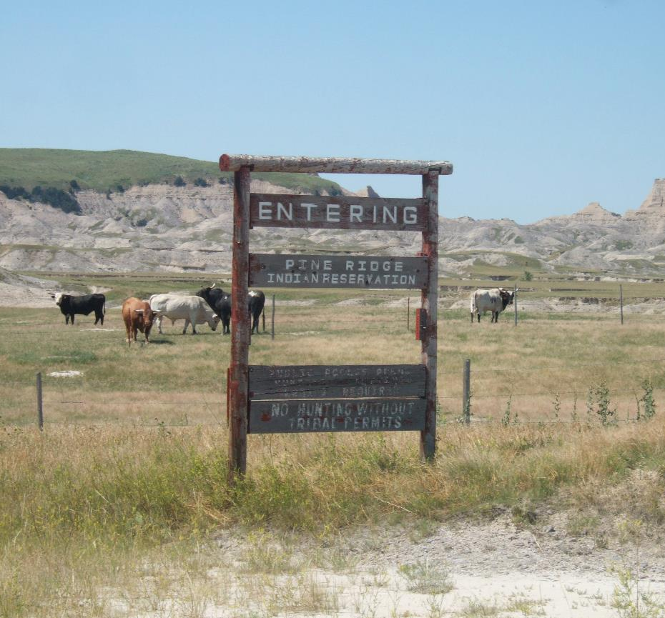
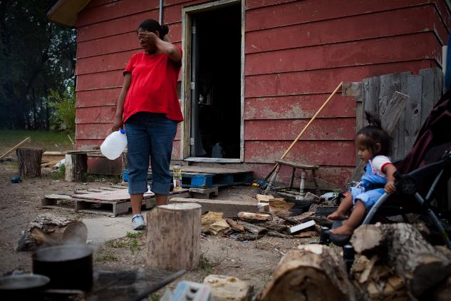
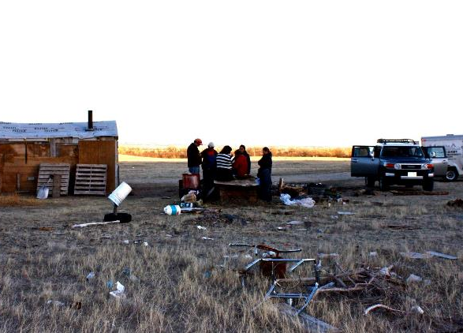

Slide 8
TRAIL OF TEARS INDIAN REMOVAL REMEBRANCE
Pine Ridge Survey *
48.3
POVERTY RATE
United States 13.8%
$9,728
ANNUAL PER CAPITA INCOME
United States $27,334
37.2
SUICIDES PER 100,000
United States 10.9
66.6
LIFE EXPECTANCY
United States 76.5
4.9mm Indians on reservations
40k live on Pine Ridge Reservation at the time of the survey
Shannon County, OK, Pine Ridge Reservation survey
*Most recent statistics available, Sources: U.S. Census Bureau; U.S. Department of Health and Human Services; South Dakota Department of Health.) RESOURCE- NATIONAL GEOGRAPHIC; In the Spirit of Crazy Horse REBIRTH OF A SIOIUX NATION

Slide 9
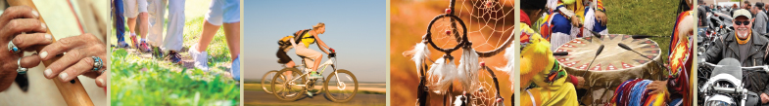
TRAIL OF TEARS INDIAN REMOVAL REMEBRANCE
Sheena V. Foundation
About
Growing up, our founder saw the plight of children in Native America today.
Throughout her life’s travels, she has seen first-hand how serious the living conditions and loss of hope & spirit exist on the reservations. She wanted to do something to make an impact, and feels we owe it to ALL Native Americans – The First People of America.
The Sheena V. Foundation (SVF), named in memory of her late niece – Sheena Vesta Osborne – who passed away from a very rare form of cancer at age 16. Parallel: Cancer ranks higher among Native American children than any other culture in our country. Thus, the inspiration for SVF and its alignment with Native America.
SVF is a non-profit 501 (c) (3) charitable foundation committed to restoring a self-sustaining environment through: Health & Wellness, Cancer Research for Children and Financial Literacy. All to preserve, protect and provide for the most valuable asset to any Native American Tribe/Nation – the children.
The foundation aims to create solutions to restore a sustainable environment that will support future generations. Our Focus: Educate Native youth on culturally appropriate long-term solutions to combat a quickly depleting environment.

Slide 10
TRAIL OF TEARS INDIAN REMOVAL REMEBRANCE
Health Insights
Disproportionate Health Challenges
In addition to having higher rates of certain kinds of cancer, Native American children have a plethora of health challenges ahead of them driven by centuries of limited access to health care, healthy food and educational and employment opportunities.

Slide 11
TRAIL OF TEARS INDIAN REMOVAL REMEBRANCE
Health Insights*
18.4
INFANT MORTALITY PER 1,000
United States 6.8
2.2
TIMES HIGHER RATE OF
DIABETES THAN WHITES
68%
INCREASE IN DIABETES
AMOUNG TEENS
95%
PATIENTS WITH TYPE II,
VERSES TYPE I, DIABETES
728
LIVER DISEASE DEATHS
PER 100,000
Unites States 9.7
*SOURCE: The American Diabetes Association

Slide 12
TRAIL OF TEARS INDIAN REMOVAL REMEBRANCE
Health Insights*
Over 50% of Indians on reservations rely on the Indian Health Service for medical care¹
  Crisis-driven only based on funding
  Wide gap in adequate and preventative health care
  Pharmacies and doctors’ offices outside of hospitals completely non-existent on some reservations
Pressure to shift from a traditional dietary ways of life to Western lifestyle dramatically changed the health of Native Americans
  Epidemic of chronic diseases such as diabetes, heart disease, tuberculosis and cancer
  20% more likely to have heart disease than other Americans and to die from it at a younger age ²
  600% more likely to die from tuberculosis³
  Disparities related to rates of cancer and cancer treatment higher than for any other Americans⁴
Suicide prevalent among Native American living on reservations
  Suicide among youth now at crisis levels
  Native American teens and young adults end their lives 3x often as their peers
¹Indian Health Facts
²American Heart Association, per Indian Health Service
³Indian Health Disparities
⁴Native People for Cancer Control; American Indian Relief Council

Slide 13
TRAIL OF TEARS INDIAN REMOVAL REMEBRANCE
Financial Insights*
Tribal and Federal governments the largest employers on the reservations
The scarcity of jobs and lack of economic opportunity
  Depending on the reservation, 4 to 8 out of 10 adults on reservations unemployed¹
  Many households overcrowded and earn only social security, disability, or veteran’s income
  Of all Indians, 28.2% live below federal poverty line² ; 38% to 63% range for those living on reservations³
Often, heads of household forced to leave the reservation to seek work. Ramifications:
  Grandparents take on the job of raising their grandchildren
  Extended families pool meager resources to meet basic needs
  Relative poverty still experienced by these blended families best described as the gap between the overall need and the need that goes unmet
Native American reservations resemble that of third world conditions⁴ or even fourth world
  Term fourth world came into use in 1974
  Refers to indigenous or cultural entities living in substandard conditions within or across a state’s boundaries
  ¹American Indian Relief Council
²American Indians Census Facts
³National Center for Education Statistics
⁴Gallup Independent

Slide 14
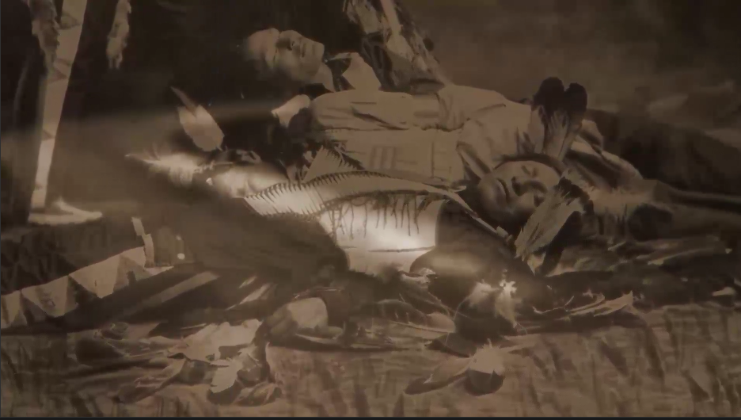
Time To Act

Slide 15
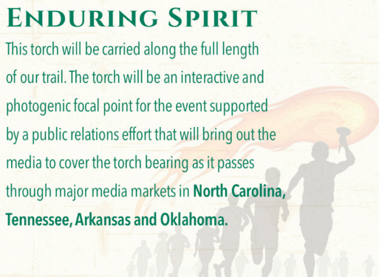
TRAIL OF TEARS INDIAN REMOVAL REMEBRANCE
Our Plan
Trail of Tears Indian Removal Remembrance (TTIRR)
It’s a celebration of the history and culture of America’s first people of the Five-Civilized Tribes and by no accident coincides with our country’s 250th anniversary! It’s a mobile education and immersion tour with routes across the country and Trail of Tears. Special focus is the Circle of Support lifting up the youth of the Native American community. TTIRR is slated to launch in June of 2026.

Slide 16
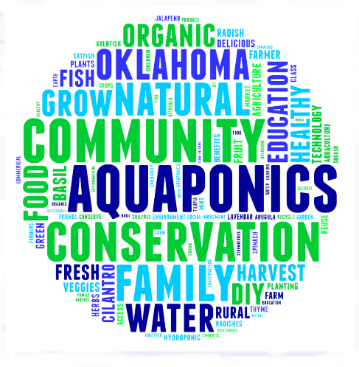
TRAIL OF TEARS INDIAN REMOVAL REMEBRANCE
Together, We Will…
Provide Native American youth with a Circle of Support:
*Health & Wellness Initiatives
Strong cancer focus
Aquaponics for food sovereignty
Housing
*Financial Awareness
*Educational Programs
-Counseling
-Including scholarships

Slide 17
TRAIL OF TEARS INDIAN REMOVAL REMEBRANCE
Experiential Tour
4 states
5 tribes
7 cities
8 days
850 miles
Hundreds of participants
Tens of thousands touched
Hundreds of thousands raised

Slide 18
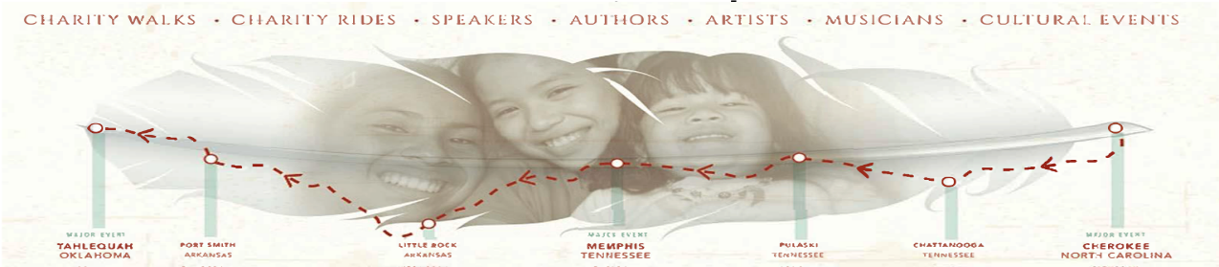
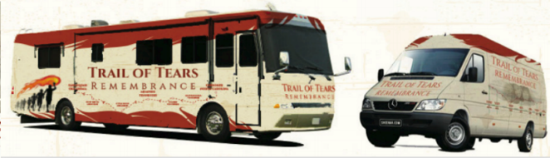
TRAIL OF TEARS INDIAN REMOVAL REMEBRANCE
How it works
Annual event commemorating one of the many historic Indian relocation routes of the 1800s
Representatives of 5 tribes caravan in theme-wrapped RVs, containers or other mobile asset

Slide 19
TRAIL OF TEARS INDIAN REMOVAL REMEBRANCE
How it works
Cherokee, North Carolina
Opening Ceremony (Cherokee)
FIRST DAY
Arrivals – Supporter Attendees/Audience i.e. – Motorcade Participates and more arrive
Formal Welcome Speech – Afternoon (after lunch ?) – Introductions – Chiefs and related dignitaries
Press event with local media – (All 3 Days)
Morning or noon TV show appearance – National TV coverage (All 3 Days)
Environment
  Historical Displays for each tribe
  Nanyehi – The Story of Nancy Ward –(Share more details)
  Food Trucks – Traditional Food
  RV educational backdrop
SECOND DAY
Sporting Events (TTIRR – Competitions w/ awards for Gold/Silver/Bronze)
  Rodeo – First Round-Series 3
  Indian Relay Races – Frist Race -Series 3
  Stick Ball – First Game - Series 3
Various Motivational Speakers including Chiefs and Veterans
Meet and Greet – Persons of Notoriety
Concerts (Rem the ladies of the Choctaws)
Major – Concert inside Casino Venue
Dancers – Pow Wow with Stomp Dancers
Fashion Show
Queens
THIRD DAY – Official Kick Off
Formal Ceremony – People of Notoriety
Lighting of the Spirit Torch Ceremony
Announce – Congratulate Sporting Event Winners (Representing Endurance)
5K – Symbolic Remembrance Walk begins with the Troch – Leading the way-After each participant – Motorcade heads out
B-roll capture for video news release
After the walk, the tour hits the trail headed for the next town

Slide 20
TRAIL OF TEARS INDIAN REMOVAL REMEBRANCE
How it works
Pulaski, TN Chattanooga, TN
Market Visit (Pulaski) Market Visit (Chattanooga)
OFFICIAL LAUNCH CEREMONIES
Remembrance walks and arrival of the Remembrance Torch
  Begin the 5K walk just outside the city limits to mark the arrival of the Remembrance Walk/Torch
RV educational backdrop
Nanyehi – The Story of Nancy Ward – (more details available)
Small town local newspaper interview
Press event with local media
Various speakers

Slide 21
TRAIL OF TEARS INDIAN REMOVAL REMEBRANCE
How it works
Memphis, TN
Mid-Tour Stop (Tribe ???)
FIRST DAY
Remembrance walks and arrival and ceremonial presentation of the Remembrance Torch. Begin the 5K walk just outside the city limits to mark the arrival of the Remembrance Walk/Torch
Arrivals – Supporter Attendees/Audience i.e. – Motorcade Participates and more arrive
Formal Welcome Speech – Afternoon (after lunch?) – Introductions – Chiefs and related dignitaries
Press event with local media – (All 3 Days)
Morning or noon TV show appearance – National TV coverage (Both Days)
Environment
  Historical Displays for each tribe
  Nanyehi – The Story of Nancy Ward –(Share more details)
  Food Trucks – Traditional Food
  RV educational backdrop
FIRST DAY (cont.)
Ceremonial Events
Small town local newspaper interview
Press event with local media
Add mid-tour concert
Tap into a local Memphis venue
Leverage talent connections of any/all partners
SECOND DAY
Sporting Events (TTIRR – Competitions w/ awards for Gold/Silver/Bronze)
  Rodeo – First Round-Series 3
  Indian Relay Races – Frist Race -Series 3
  Stick Ball – First Game - Series 3
Various Motivational Speakers including Chiefs and Veterans
SECOND DAY (cont.)
Meet and Greet – Persons of Notoriety
Concerts (Rem the ladies of the Choctaws)
Major – Concert inside Casino Venue
Dancers – Pow Wow with Stomp Dancers
Fashion Show
Queens
Formal Ceremony – People of Notoriety
Lighting of the Spirit Torch Ceremony
Announce – Congratulate Sporting Event Winners (Representing Endurance)
5K – Symbolic Remembrance Walk begins with the Troch – Leading the way-After each participant – Motorcade heads out
B-roll capture for video news release

Slide 22
TRAIL OF TEARS INDIAN REMOVAL REMEBRANCE
How it works
Little Rock, AR Fort Smith, AR
Market Visit (Tribe ???) Market Visit (Tribe ???)
OFFICIAL LAUNCH CEREMONIES
Remembrance walks and arrival of the Remembrance Torch
  Begin the 5K walk just outside the city limits to mark the arrival of the Remembrance Walk/Torch
RV educational backdrop
Nanyehi – The Story of Nancy Ward – (more details available)
Small town local newspaper interview
Press event with local media
Various speakers

Slide 23
TRAIL OF TEARS INDIAN REMOVAL REMEBRANCE
How it works
Tahlequah/Tulsa/BOK, OK
Final Stop – 850 MILE Endurance
Casino Partners – Concerts, signage, etc.
FIRST DAY – Events captured throughout Tahlequah, Tulsa and BOK Convention Center
Arrivals – Supporter Attendees/Audience i.e. – Motorcade Participates and more arrive
Formal Welcome Speech – Afternoon (after lunch?) – Introductions – Chiefs and related dignitaries
Press event with local media – (Both Days)
Morning or noon TV show appearance – National TV coverage (Both Days)
Environment
  Historical Displays for each tribe
  Nanyehi – The Story of Nancy Ward –(Share more details)
  Food Trucks – Traditional Food
  RV educational backdrop
SECOND DAY
Sporting Events (TTIRR – Competitions w/ awards for Gold/Silver/Bronze)
  Rodeo – First Round-Series 3
  Indian Relay Races – Frist Race -Series 3
  Stick Ball – First Game - Series 3
Special Ceremony – Final Lighting of Torch – Awards for all Three TTIRR – Gold/Silver/Bronze
Big “Blow Out” Concert Series – Local Oklahomans -i.e. Blake Shelton – Reba McEntire – Garth Brooks – Carrie Underwood etc….and others George Strait – Allen Jackson – Laney Wilson Etc
Various Speakers-Veterans- Chiefs –“Motivational ‘ i.e. Historic & Positive
SECOND DAY (cont.)
Meet and Greet – Persons of Notoriety
Concerts *Rem the ladies of the Choctaws)
Major -Concert -Inside Casino Venue-Inside BOK Convention Ctr
Dancers – Pow Wow -Stomp Dancers
Fashion Show-
Queens-
2027
Next Route TBD…

Slide 24
TRAIL OF TEARS INDIAN REMOVAL REMEBRANCE
“What we do today
impacts seven generations
tomorrow.”
Chief Bill Baker, Oklahoma Cherokee Nation

Slide 25
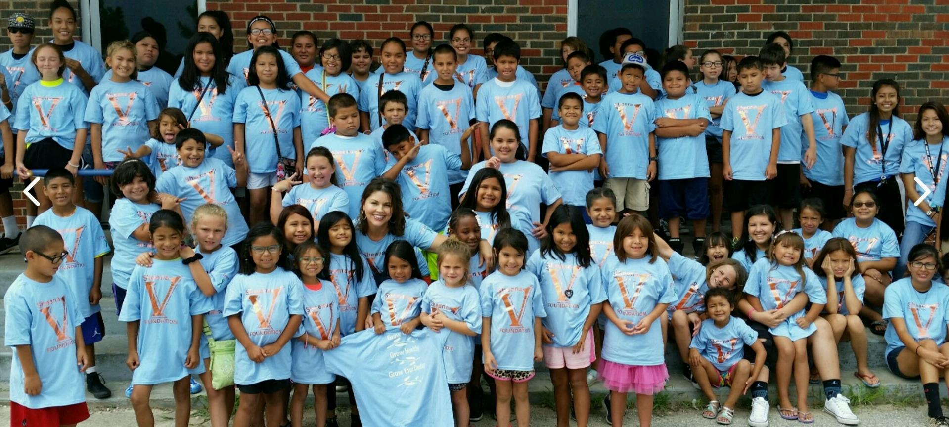
Thank You!

